Slide 1

Predicting House Prices by Number of Bedrooms
DATAAVS200
Adam F. Campbell

Slide 2
Final Project Presentation Topics
1. Situation or problem statement: describe what the situation is, what you are trying to figure out and why.
2. Key Question(s): Describe the key question(s) in terms of the variable your team selected to spotlight.
3. Data Source(s): Provide a full description of where the data comes from.
4. Data Wrangling: What you did to organize the data
Removed columns: …. why?
Converted columns: … why?
Transform data: gather(); summarize(); distinct(); sort(); etc
5. Data Exploration/ Visuals: Provide a few of the visuals you used to explore the data.
7. Conclusions: Describe the final solution that answers the key questions.

Slide 3
1. Problem statement: describe what the situation is, what you are trying to figure out and why.
Is it possible to predict the price of a house only by the number of bedrooms?
The most common method for describing the feature of a house is the number of bedrooms and bathrooms
Using only the number of bedrooms in a house (x) is it possible to determine the price (y)?
Are other factors needed to make an accurate prediction on the price of a house?

Slide 4
2. Key Question(s): Describe the key question(s) in terms of the variable your team selected to spotlight
The primary terms are the price and number of rooms in the house
When a house is listed for sale numerous factors are listed in the house description, Number of bed/bath, square footage, number of floors, year built, lot size etc..
Can a house price be predicted solely by the number of bedrooms?
How many factors would need to be included to make an accurate prediction and which factors are the most important?

Slide 5
Data Source(s): Provide a full description of where the data comes from.
The data was the KC_house_data provided by the course
The data contains 21,613 observations with 21 variables including the price the house was sold for, number of bedrooms and number of bathrooms
Most of the variables were not needed for the model and removed during data clean up

Slide 6
Data Wrangling: What you did to organize the data
Data Wrangling: What you did to organize the data: the dataset was simplified by removing columns
Removed columns: almost all columns were removed from the data set. Only Price, bedrooms, bathrooms and zip code were kept in the data set
Converted columns: bedrooms was converted using as.integer() for use in the boxplot graph
Transform data: The dataset was filtered for only one zipcode 98007

Slide 7
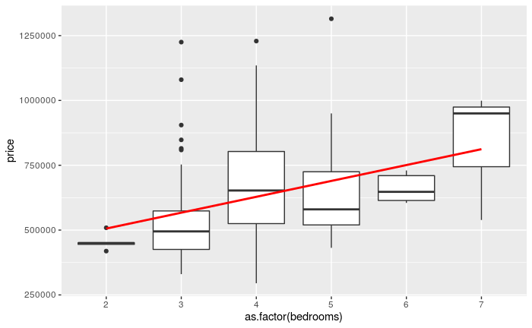
The Relationship Between Bedrooms and Price
Boxplot to determine if there was a range of prices for a 2,3,4 bedroom house. Also to discover if there were any outliers in the data.
A large number or outliers for 3 bedrooms
An upward trend in price/bedroom but no avg significant increase
in price from 4 - 6 bedroom.

Slide 8
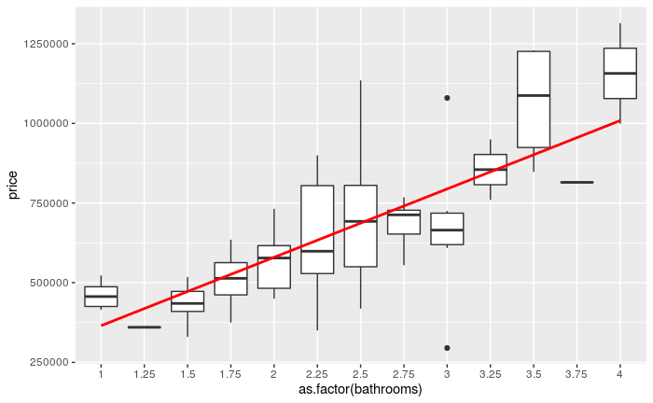
The Relationship Between Bathrooms and Price
This visual describes the relationship between bathrooms and price.
A general trend of increase in price per bedroom exists with some caveats:
There is a $250k increase in house price when going from 1.75 to 2.75 bathrooms.
A 3rd bathroom does not increase the price of a house.

Slide 9
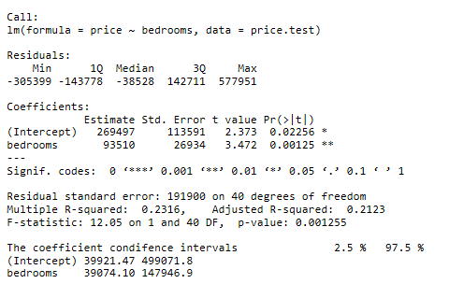
Regression Model Statistics
There is a large dispersion of the residuals means the predicted values were not accurate
Coefficients, the std error is large signifying that the model is not accurate
R-squared is low at only 0.2 meaning the data is not close to the regression line.

Slide 10
Conclusions: Describe the final solution that answers the key questions
The conclusion is that only using the number of bedrooms is not sufficient to accurately predict the price of a house.
Additional coefficients would need to be used in order to accurately predict the price of a house such as number of bathrooms, year built, lot size as well as the price of houses recently sold that have similar additional characteristics.

Slide 11
“Buy land, they’re not making it anymore.”
- Mark Twain

